Slide 1
Sense Groups / Thought Groups and Emphasis Markers

Slide 2
1. The government of India said the Chief Minister of Maharshtra has grossly neglected the incidence of Covid-19.
1a. The government of India/ said the Chief Minister of Maharshtra/ has grossly neglected/ the incidence of Covid-19.
Vs
1b. The government of India said/ the Chief Minister of Maharshtra / has grossly neglected/ the incidence of Covid-19.
Notes:
Note: Through slides 2 to 4 students should be given an idea of how place of pause(s) in a sentence brings variation in the meaning.

Slide 3
2. A woman without her man is nothing.
2a. A woman/ without her/ man is nothing.
Vs
2b. A woman without her man/ is nothing.

Slide 4
3. Do you take sugar?
3a. / I don't / no /
Meaning: I don't, no.
3b. / I don't no/
Meaning: I don't know.

Slide 5
4. The prince said the princess had been unfaithful.
4a. The prince said / the princess had been unfaithful./
Meaning: The prince said (that) the princess had been unfaithful.
4b. / The prince / said the princess / had been unfaithful./ Meaning: "The prince," said the princess, "had been unfaithful."

Slide 6
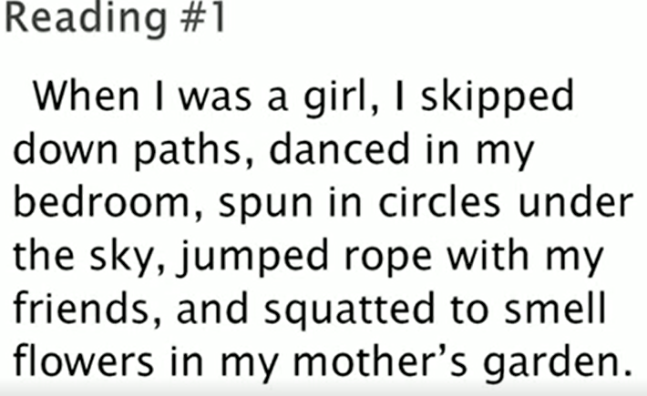
Notes:
Refer to Jennifer’s video 1

Slide 7
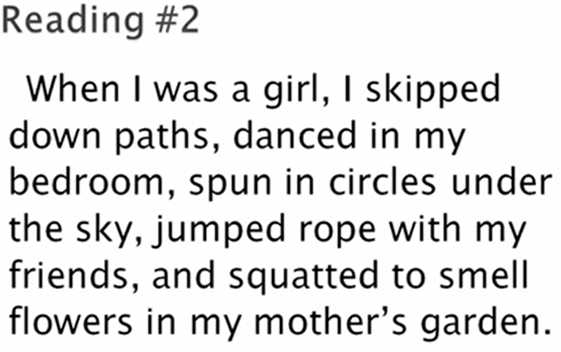
Notes:
Refer to Jennifer’s video 1

Slide 8
Sense Groups/ Thought Groups
A group or sequence of words conveying a particular meaning or idea
Allow you to organize your speech into groups of words that make up a single idea
Help your listener(s) better understand the information in your speech by organizing your ideas into comprehensible “packages”
Different speakers can and do use thought groups differently (refer to slides 2-5)

Slide 9
Identifying Thought Groups
1. Punctuation
When we read aloud, the writer’s punctuation tells us where to pause:
comma = ,
period = .
semicolon = ;
colon = :
parenthesis = ()
Notes:
Refer to Jennifer’s vedio

Slide 10
Cont…
2. Grammar
Identification of grammatical units in a sentence
Pausing between larger grammatical units creates natural rhythm

Slide 11
Grammatical Units
Noun phrases
the blue-eyed girl
Verb phrases
have been studying
Prepositional phrases
on the table
Clauses
When I was a student, I studied for hours.
Notes:
Refer to Jennifer’s video

Slide 12
Read
A blue-eyed girl/ entered the classroom.//
A blue-eyed girl/ and her best friend/ entered the room.//
The blue-eyed girl/ is playing with her brother.//
The teacher,/ whom I loved most,/ has resigned.//
Notes:
Concept of single slash and double slash may be introduced here. Refer to Jennifer’s video

Slide 13
Avoid breaking up short sentences
I came.
Vs
I came, I saw, I conquered.
I danced.
Vs
I danced in the auditorium.

Slide 14
Thought groups usually end with content words (not function words)
Content Words
Usually nouns, main verbs, adjectives and adverbs
Function Words
Usually pronouns, articles, auxiliary verbs, and prepositions

Slide 15
Focus Word
Usually the last content word in the thought group.
Is usually louder and longer
For example:
The first item/ on our agenda/ is to address parking.

Slide 16
Identify (1) the most likely thought group boundaries and (2) the focus word in each thought group
I’d like to introduce my wife Nita.
If you take care of the accounts I’ll handle the meeting.
Microsoft CEO Satya Nadella started a charity to fight poverty.
My new phone is acting up so could you email me instead?

Slide 17
Answers
I’d like to introduce my wife/ Nita.
If you take care of the accounts/ I’ll handle the meeting.
Microsoft CEO Satya Nadella/started a charity/ to fight poverty.
My new phone is acting up/ so could you email me instead?

Slide 18
Emphasis

Slide 19
Emphasis
You have stolen my pen.
You have stolen my pen.
You have stolen my pen.

Slide 20
Emphasis
I want you to read it aloud.
I want you to read it aloud.
I want you to read it aloud.
I want you to read it aloud.
I want you to read it aloud.
I want you to read it aloud.

Slide 21
Emphasis
the extra force that you give to a word or part of a word when you utter it
to reinforce or to give special meaning to the part of an utterance
the emphasized part(s) of a sentence is/are louder and longer.

Slide 22
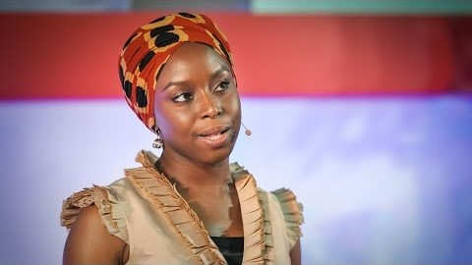
Practice: TED Talk by Chimamanda Ngozi Adichie, entitled “The danger of a single story.”
Notes:
Instruction: Listen to the video as you read the text below, and make a note of where you think Adichie separates her thought groups.
Link of the transcript may be shared with the students. The students will listen and read at the same time.
A sample answer is here:
I’m a storyteller / and / I would like to tell you a few personal stories about / what I like to call the danger / of the single story / I grew up on a university campus / in eastern Nigeria / my mother says that I started reading at the age of two / although I think four is probably close to the truth / so I was an early reader / and what I read / were British and American children’s books / I was also an early writer / and when I began to write / at about / the age of seven / stories in pencil with crayon illustrations that my poor mother was obligated to read / I wrote exactly the kinds of stories I was reading / all my characters were white / and blue-eyed / they played in the snow / they ate apples / and they talked a lot about the weather / how lovely it was that the sun had come out / now this despite the fact / that I lived / in Nigeria / I had never been outside Nigeria / we didn’t have snow / we ate mangoes / and we never talked about the weather because there was no need to/

Slide 23
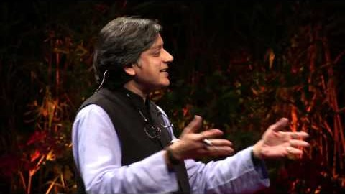
Practice: Shashi Tharoor on A Well Educated Mind Vs a Well Formed Mind
Notes:
Instruction: Listen to the video as you read the text below, and make a note of where you think Mr Tharoor separates his thought groups.
Link of the transcript may be shared with the students. The students will listen and read at the same time.

Slide 24

This Photo by Unknown Author is licensed under CC BY-NC-ND

